Slide 1
Welcome V.I.P.s! Please help yourself to refreshments.
While you wait for us to begin, please do the following:
Browse the books on the counter
Think about the two questions on the charts
Write some titles on the sticky notes at your table.

Slide 2
Reading At Home (RAH) Being a Reading Cheerleader: WHY
Give a “thumbs up” or “thumbs down” for each of these ideas:
Reading at home is important.
Kids who read well will have better opportunities in life.
The more time kids spend reading, the better readers they will become.
I have at least one reluctant reader at home.

Slide 3
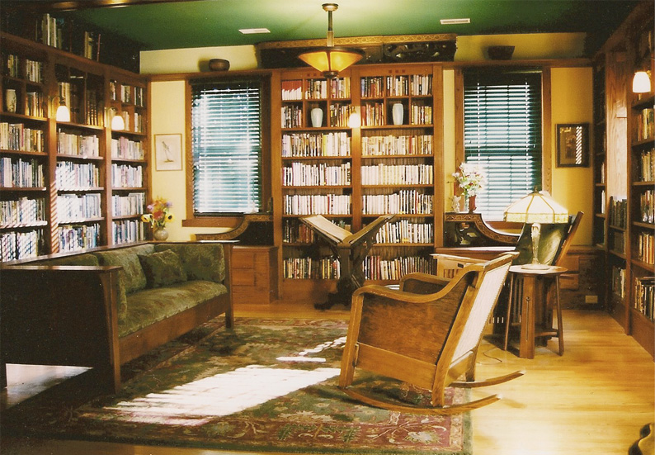
Reading at home is important.
Books in the home is as important as parents’ educational level in determining level of education children will attain.
-Research in Social Stratification and Mobility, June 2010

Slide 4
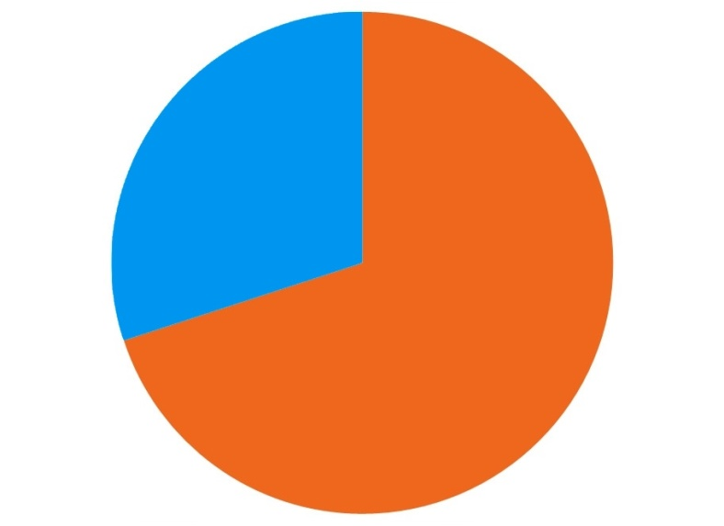
Kids who read well will have better opportunities in life.
70% of prison inmates fall into the lowest level of reading proficiency
75% of today’s jobs require at least a 9th grade reading level
70 %

Slide 5
The more time kids spend reading, the better readers they will become.
Time Spent reading vs. 5th Grade Reading Achievement
% rank on reading tests | Minutes reading per day | Number of words read/year
98 | 90.7 | 4,733,000
90 | 40.4 | 2,357,000
70 | 21.7 | 1,168,000
50 | 12.9 | 601,000
20 | 3.1 | 134,000
10 | 1.6 | 51,000

Slide 6
Okay, now what? HOW to be a Reading Cheerleader
Reading with your child
Finding books your child will love to read on their own
Why you should still be reading aloud at this age
How to make the most of it
Choosing good books
The power of choice
Series books
Recommendations and resources for finding more

Slide 7
Reading with your child
John Lithgow video
What stood out to you?
What words or phrases resonated with your experience or seemed like a new idea for you?

Slide 8
How to make Your Child HATE Reading With You In Four Easy Steps
And also what you should do to make them LOVE it!

Slide 9
Step 1
Tell them you are doing it because the teacher told you to. Better yet, tell them you’re doing it because it’s good for them!
To make them LOVE reading with you, tell them you’re doing it because you have a good book that you want to share with them. Lifelong readers do not read like they take vitamins. They read like they’re going on a vacation – for fun!

Slide 10
Step 2
Ask them “Comprehension Questions” at the end of each chapter. If questions like “What was the main idea of the chapter?” don’t turn them off right away, a “5 Finger Retelling” should do the trick!
To make them LOVE reading with you, have a real conversation about the book. Ask them what they think about the characters and what they are going through. Choose books with enough complexity to have big conversations about important ideas.

Slide 11
Step 3
Read in a flat voice, with no inflection whatsoever. Never do character voices, especially silly ones! If you make a mistake or sound weird, they might get the idea that making mistakes and trying new things are okay!
To make them LOVE reading with you, be expressive! Use your whole face to convey the emotion in the book. When the character is upset, try adding a choked-up sob to your reading. Do a deeper voice for the evil villain; try an accent for the English schoolmaster.

Slide 12
Step 4
Don’t say anything about the story you’re reading. Don’t react to it at all. Showing empathy, disbelief, outrage or confusion will only show your child that you are really into the story, which will make them love reading with you.
To make them LOVE reading with you, share your own thinking and reactions. When you close the book and gasp, “Oh my gosh, what is Harry thinking?! How could he do that?” you are showing that stories are worth becoming emotionally invested in. And sharing these emotional connections creates a close bond like no other!

Slide 13
Choosing good books to read aloud
Suggestions from the group?

Slide 14
Finding books your child will love to read on their own
It’s okay to MAKE THEM read everyday,
but they should choose
WHAT they read!

Slide 15
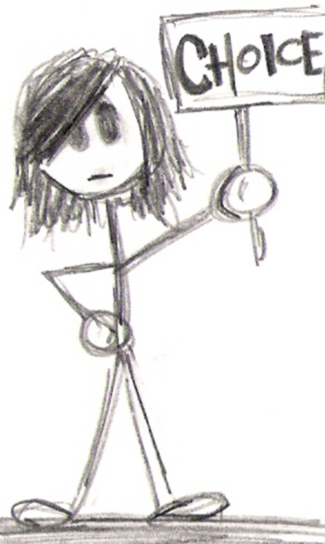
Allow Children To Choose
Empowers and encourages them
Strengthens their self-confidence
Rewards their interests
Promotes a positive attitude toward reading by valuing the child
Readers without the power to make their own choices are UNMOTIVATED

Slide 16
Now for a long Quote:
Students who consistently read for their own interest are often quite competent and are usually highly achieving readers. Wigfield and Guthrie (1997) documented that students who are intrinsically motivated* spend 300% more time reading than students who have low intrinsic motivation for reading. Compared to 10 other motivations, intrinsic motivation for reading was most highly associated with whether or not students read widely and frequently on their own accord.
-Angela McRae and John T. Guthrie (2008)
And a short one:
If we want children to love reading, choice is more important than taste!
- Mrs. Freeman (today)

Slide 17
Using Series to promote reading
Advantages of Series Books
Build background knowledge, which makes reading subsequent books easier!
Story becomes more complex over time, deepening comprehension.
There is always a new book waiting for them!
Types of Series
Sequential books with connecting plots that happen chronologically. These types of books are meant to be read in order beginning from book one.
The characters and setting might be the same in all the books, but each book can be read independently and in any order.

Slide 18
Book Recommendations
What has your child enjoyed reading in the past year or so?

Slide 19
Finding MORE books
Kids Book Series website has lists of book series for kids, which you can search by age, reading level and interest. http://www.kidsbookseries.com/index.php
Nerdy Book Club is a blog maintained by a group of teachers to promote reading communities. They are always reviewing new books; check out their annual “Nerdy Awards” lists for surefire new books. http://nerdybookclub.wordpress.com/
Try the Scholastic Book Wizard to find books similar to ones your child already likes. Use the “Search for Similar Books” tab. http://www.scholastic.com/bookwizard/

Slide 20
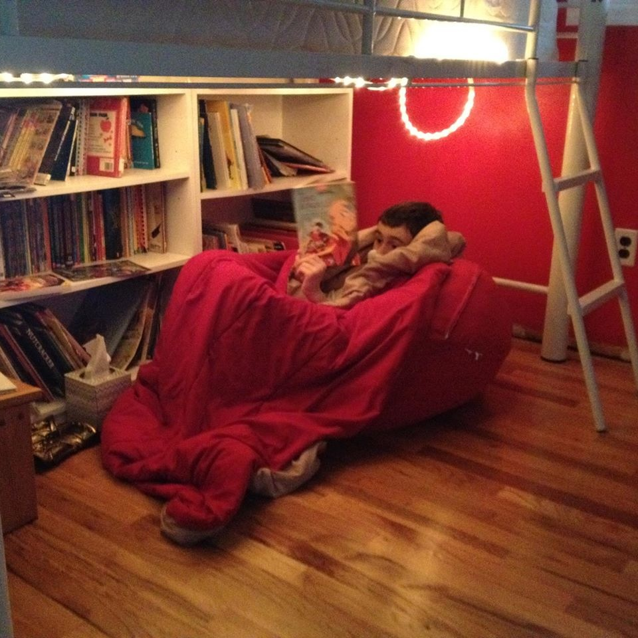
Happy Reading to all!
Please take a moment fill out an exit survey, so I can improve the presentation in the future! ☺

Slide 21
Credits
Thank you to my colleagues, Lori Ulewicz and Colleen Mestdagh for sharing content from similar presentations. Content on slides 3 - 5, 15, and 16 (in part) should be credited to them.
All other content was created by Emily Freeman.
Content on slides 8 - 12 was influenced by the book Reading Magic, by Mem Fox.
Content on slide 17 was adapted from www.kidsbookseries.com.
This work is licensed under a Creative Commons Attribution-ShareAlike 4.0 International License. If you would like to use this presentation in whole or in part, please be sure to maintain these credits.

